Slide 1
Prediction of Health Insurance Cost
NAME : PRAJUDI WILLIAM CHRISDEARDO
BRANCH: DS JAN 2021

Slide 2
Motivation, Problem Statement and Business Value
Motivation
Because I want to understand the topic that I take up.
Problem Statement
I will do it by using a regression calculation model, accompanied by several types of algorithms.
Business Value
The benefits are what factors affect the cost of health insurance.

Slide 3
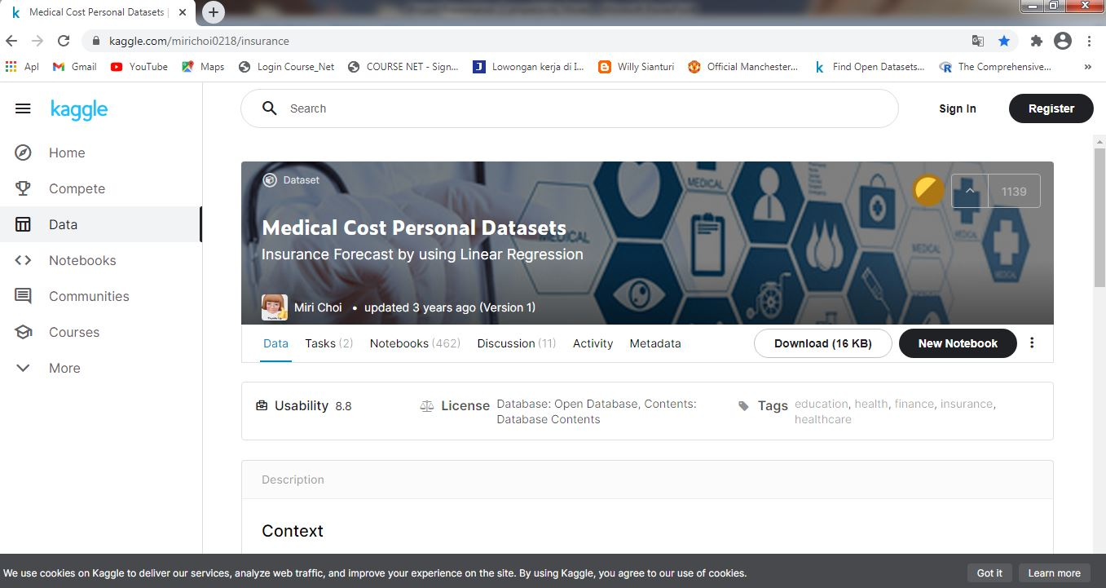
Dataset

Slide 4
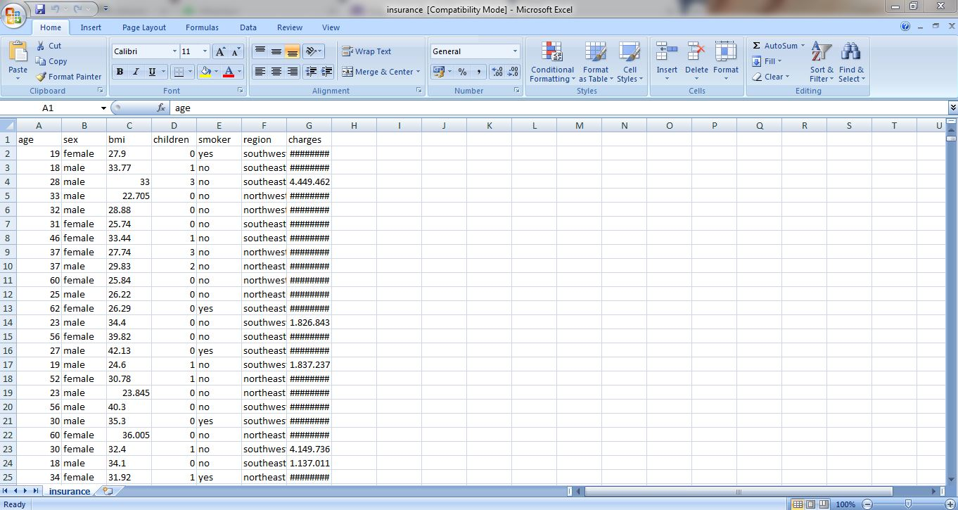
Dataset

Slide 5

Check for Missing Values

Slide 6
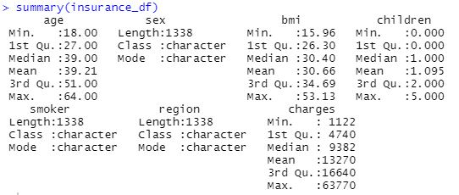
Check for Missing Values

Slide 7
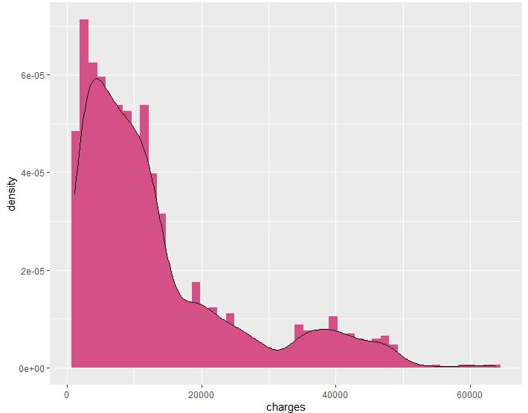
Charges

Slide 8
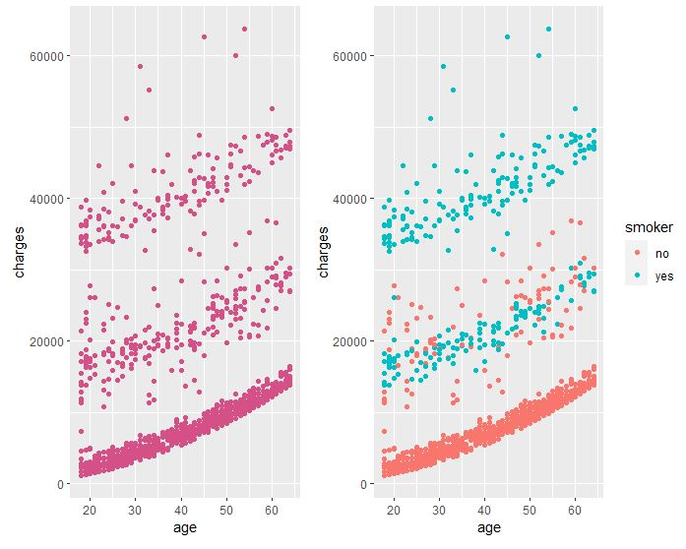
Age

Slide 9
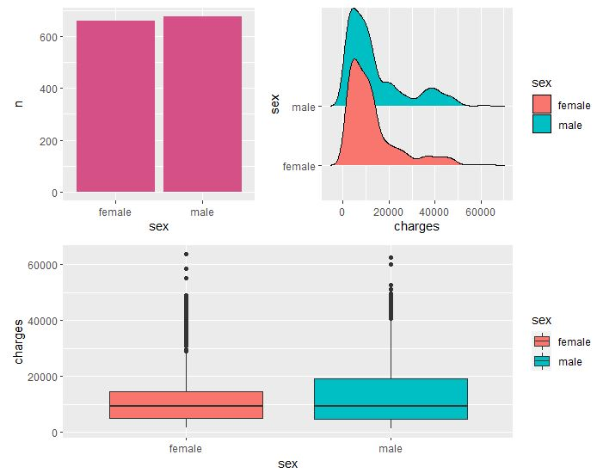
Sex

Slide 10
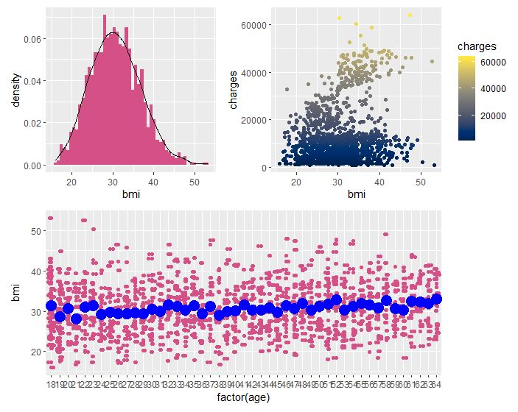
BMI (Body Mass Index)

Slide 11
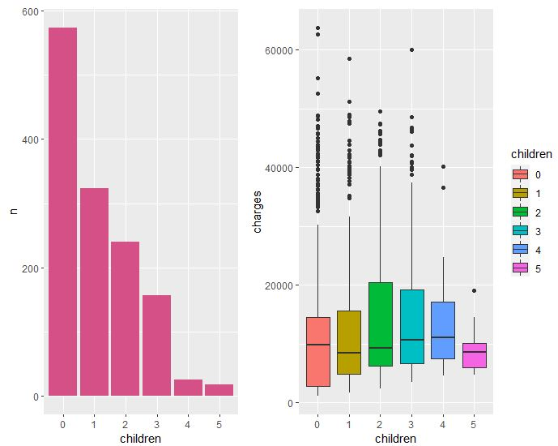
The Number of Children

Slide 12
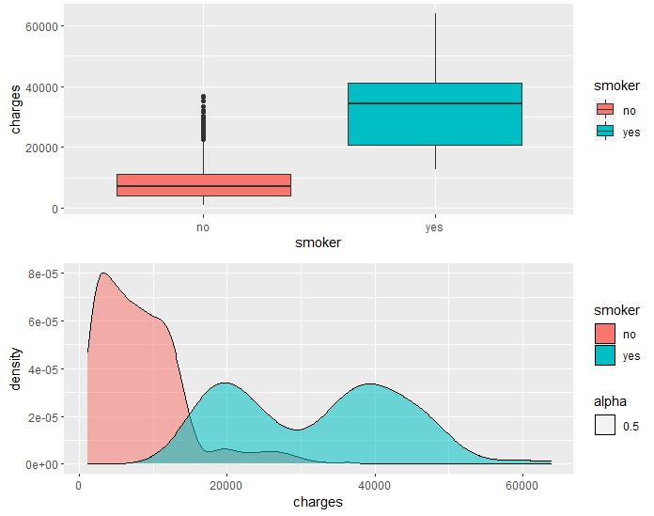
Smoker

Slide 13
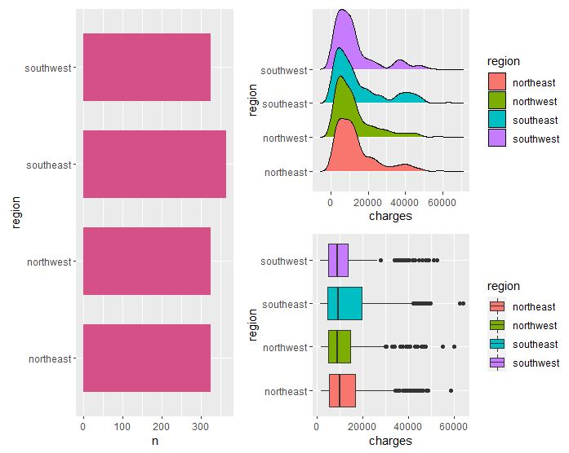
Region

Slide 14
Algorithm
Types of models in regression:
1. Simple Linear Regression
2. Polynomial Regression
3. Multiple Linear Regression
4. Multiple Linear Regression with Interaction

Slide 15
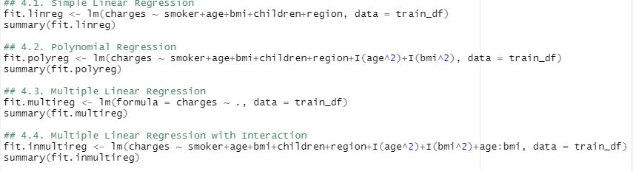
Formulas

Slide 16
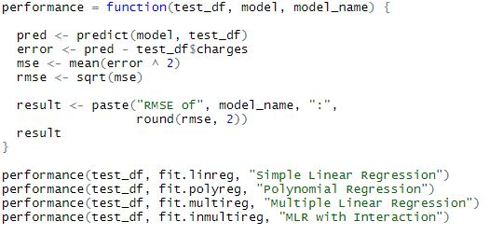
Evaluate the Model

Slide 17
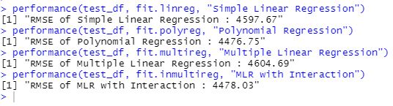
Results

Slide 18
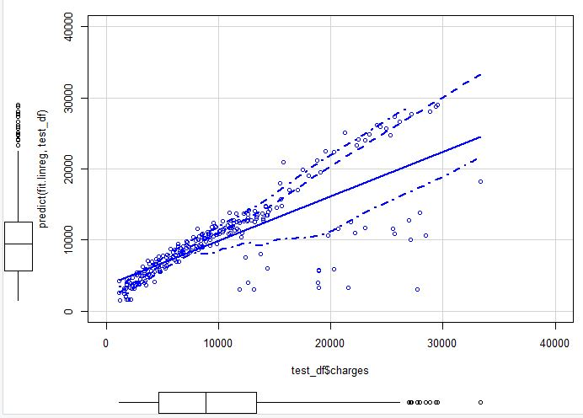
Results (Simple Linear)

Slide 19
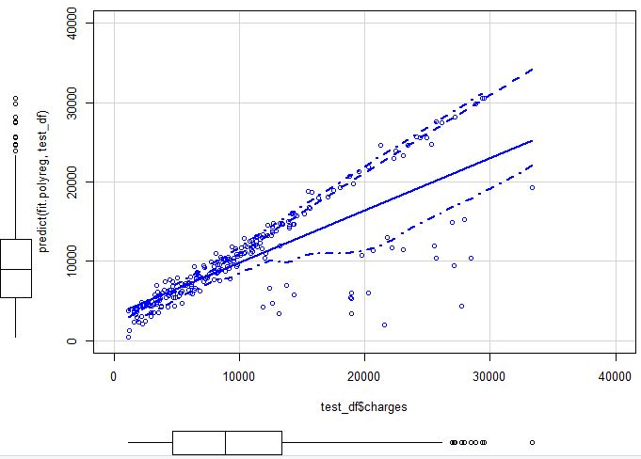
Results (Polynomial)

Slide 20
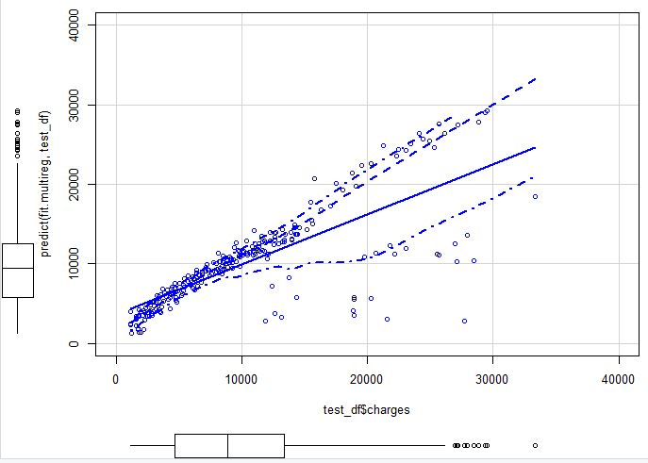
Results (Multiple Linear Regression)

Slide 21
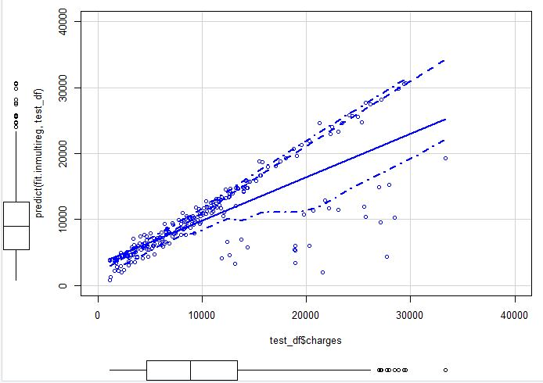
Results (MLR with Interaction)

Slide 22
Recommendation
1. Of the four types of regression models we use, the smaller error count is 4476.75 (Polynomial Regression).
2. Factors that influence the cost of health insurance are weight, age, smoking and gender.
3. Based on the results of the graph, the prediction of health insurance costs is below 20,000.

